Slide 1

Accessible Word Document Basics
Mark McCarthy, MSIM, IADP, CPWA
9/17/21 CARLI PDA Series

Slide 2

Agenda
What defines disability?
Language perspectives
The meat and potatoes: Word
  Headings
  Lists
  Images
  Readability
  Oh my!
Securing documents and PDF discussion
Accommodation statements
Live example (time permitting)
Summary
Wrap-up/Q&A

Slide 3

Disability?
The ADA defines a person with a disability as a “person who has a physical or mental impairment that substantially limits one or more major life activity. The ADA also makes it unlawful to discriminate against a person based on that person’s association with a person with a disability.”
Likely more people than you think live with disabilities!
  About 15% of the world’s population – that’s 1 BILLION people – live with a disability.
    That’s more than the entire population of Europe, and only a little less than all of China!
  The CDC estimates about 26% of Americans – 1 in 4 – live with a disability. That’s 10x NYC!
  Disabilities can be mixed and matched or taken à la carte!
  Disabled folks are the worlds’ majority minority.
  It’s not a bad word!
Photo via Anna Shvets on Pexels

Slide 4
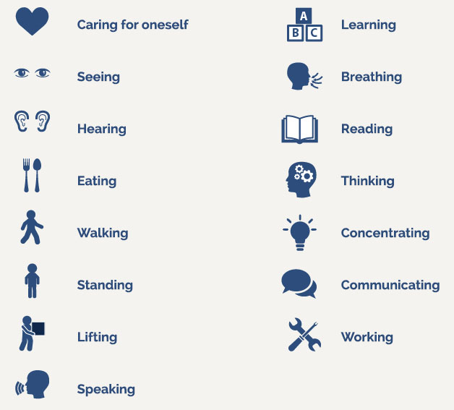
Major life activities?
Major life activities, or activities of daily living, can include things like, but are not limited to:
  Self-care
  Eating
  Hearing
  Seeing
  Walking
  Speaking
  Thinking
  h/t Lindsay Haitz
  Photo via The CP Lawyer, 2021

Slide 5
Person-First Language
Person with a disability
Individual with _____ (e.g., epilepsy, psychiatric disability, intellectual disability, mental illness, etc.)
Person who is ____ (e.g., deaf, blind, hard of hearing)
Individual who uses a ____ (e.g., wheelchair, cane, walker)
Person who has _____ (e.g., depression, anxiety, ADHD)
H/t Lindsay Haitz

Slide 6
Identity-First Language
Some individuals prefer Identity-First language
Disabled Person
Deaf Person (Big D refers to Deaf culture, little d refers to medical condition of deafness)
Autistic Person
Some things to think about…
There will always be exceptions,
Ask if you are in a position to ask,
When referring to a broad community use default language most commonly used by members of the community (not parents or allies),
Pay attention to how the person refers to themselves.
This is a lot like, and intersects with, interacting with queer folx!
H/t Lindsay Haitz

Slide 7
Word is Powerful!
Word can do a LOT, maybe more than you thought!
Headings
Lists
Image support
Formatting and styling
Security, or the illusion of…
This presentation is great reference material!
(I apologize in advance for the coming deluge of Microsoft terms…)

Slide 8
Headings
Headings are important for a variety of reasons.
Provides a sight-dependent user the means to quickly scan and chunk a page.
Gives a screen reader user (remember not all of them are blind) the ability to quickly jump between them via keyboard.
Gives everyone access to Word’s Navigation Pane, allowing quick parsing of long documents.
There are 6 heading levels to use, Heading 1 only being used once. * In most standard cases. It can sometimes be used twice.

Slide 9
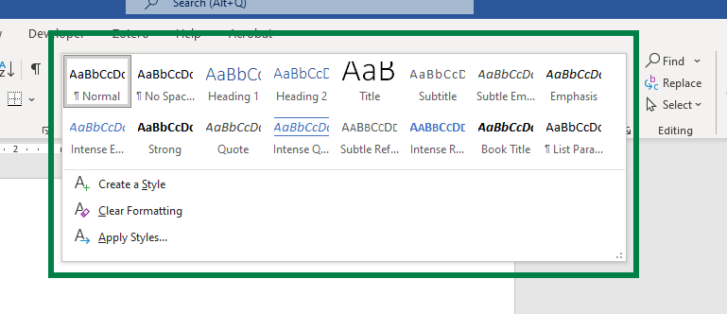
Awesome, how do I use headings?
When in Word:
Find your Ribbon at the top of the window.
Under the Home tab of the Ribbon, find the Styles pane.
Select the heading you want to use!
  Feel free to restyle it with different (contrasty) colors or different (legible) fonts.
  Examples will be provided!
More heading levels will appear as you use them!
Note: Don’t use the other styles options – they do not provide the same meaning as H1-H6. Notably, the “Title” style used to (may still) appear in a PDF as an H4. Don’t ask why.

Slide 10
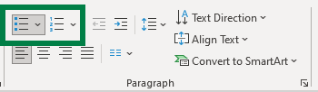
Lists
You may be more familiar with lists, since Word nudges you to use them.
Unordered lists (like this one, with bullets) are useful for information where the order doesn’t matter.
  Think about ingredients for a recipe.
Ordered lists (with numbers) are useful where order matters.
  Think about the steps to a recipe.
Chunks up information, making it easier to parse and read than if it was in a narrative format.

Slide 11
Can I see an example?
Sure! Here’s the same content, in paragraph form.
You may be more familiar with lists, since Word nudges you to use them. Unordered lists (like this one, with bullets) are useful for information where the order doesn’t matter. Think about ingredients for a recipe. Ordered lists (with numbers) are useful where order matters. Think about the steps to a recipe. Chunks up information, making it easier to parse and read than if it was in a narrative format.

Slide 12
Images
Feel free to use images in your documents! Just a few things:
Does your image contain text? Make sure it’s legible and contrasty, or (better) written out in the document.
Does your image have a meaning, or is it for fluff?
  If it has meaning, it needs alternative text! Right-click your image or access it from the Selection Pane, choose Edit Alt Text, and include your description.
    Think about how and what you would describe to someone on the phone.
  If it is for fluff, it’s decorative! Same steps as before but check the Mark as Decorative checkbox.
    This goes for shapes (like the lines and shapes in this presentation) too.

Slide 13
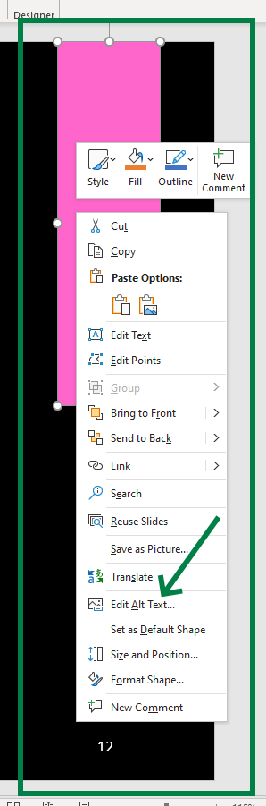
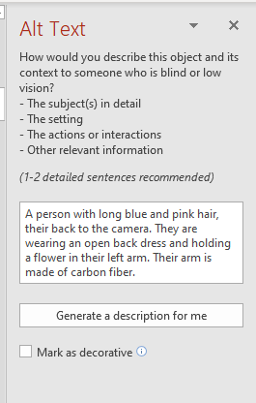
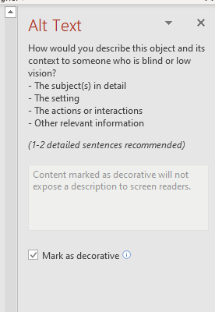
How to describe an image
Find the image you’d like to describe,
Right click, or access via the selection pane, and choose “Edit Alt Text”
Use your desired method!

Slide 14
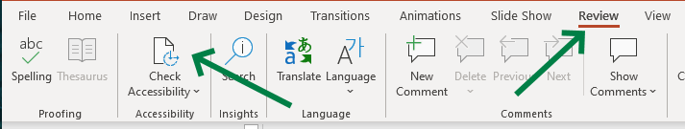
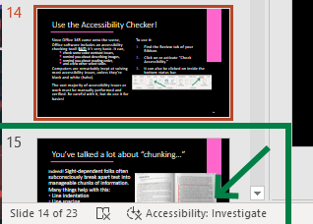
Use the Accessibility Checker!
Since Office 365 came onto the scene, Office software includes an accessibility checking tool! BUT: it’s very basic. It can,
  check some color contrast issues,
  remind you about describing images,
  remind you about reading order,
  and a few other select tasks.
Computers are remarkably inept at solving most accessibility issues, unless they’re black and white (haha).
The vast majority of accessibility issues or work must be manually performed and verified. Be careful with it, but do use it for basics!
To use it:
Find the Review tab of your Ribbon.
Click on or activate “Check Accessibility.”
It can also be clicked on inside the bottom status bar.

Slide 15
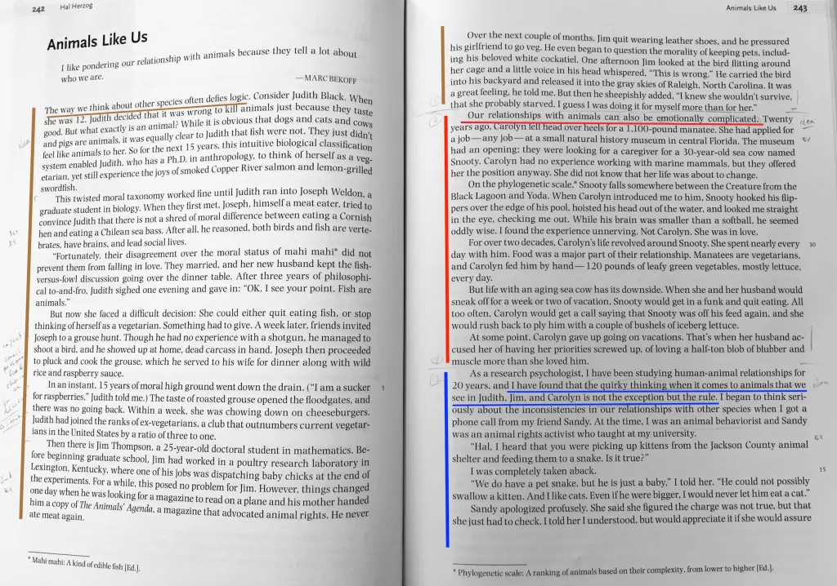
You’ve talked a lot about “chunking…”
Indeed! Sight-dependent folks often subconsciously break apart text into manageable chunks of information. Many things help with this:
Line indentation
Line spacing
Headings
Font size
Font face
Sentence length
Photo via Dr. Eric Drown @ University of New England

Slide 16
Chunking, now I’m getting it…
Here are some tips to help! Especially if your documents will be printed and displayed. Vs. accessing the Word document directly.
Use Tabs*( to indent your lines.
Try to break apart paragraphs logically.
Use 1.5 (or greater) line spacing.
Keep line lengths to about 70 characters, with some error depending on font size.
*Using Tabs vs. Spaces can be very helpful if someone is accessing your document on a computer, if they have particular settings they use. This matters more in programming, but good to know anyway.

Slide 17

A quick note on PDF “security…”
“I use PDFs because they’re more secure!”
“PDFs look nicer.”
“PDF is my favorite acronym.”
I’ve heard it all. PDFs are no more, and perhaps less, secure than Word documents. PDFs are a printer’s (both the profession and 80s hardware) format and were more important before modern word processors.
They are almost always less accessible and can take up to an hour per page to make accessible – even by experts.
In short, PDFs SUCK! (Yes, they have a place, but I’m biased today.) (This video is educational I promise.)
Use a DOCX instead.
BG via Linus Tech Tips

Slide 18
OK smart guy, how do I secure a DOCX?
Word provides many options for restricting access, editing, and more. Under the Info menu in the File tab:
Click Protect Document,
Choose Open Read Only, Mark as Final, Restrict Editing, or Restrict Access.
These all do different things, but if you are concerned about security, Restrict Editing or Access may be the most useful. Word provides explanations for each of these as you use them.
Note: Whether a PDF or DOCX, text can almost always be copied out, or formats modified, by intrepid individuals.

Slide 19
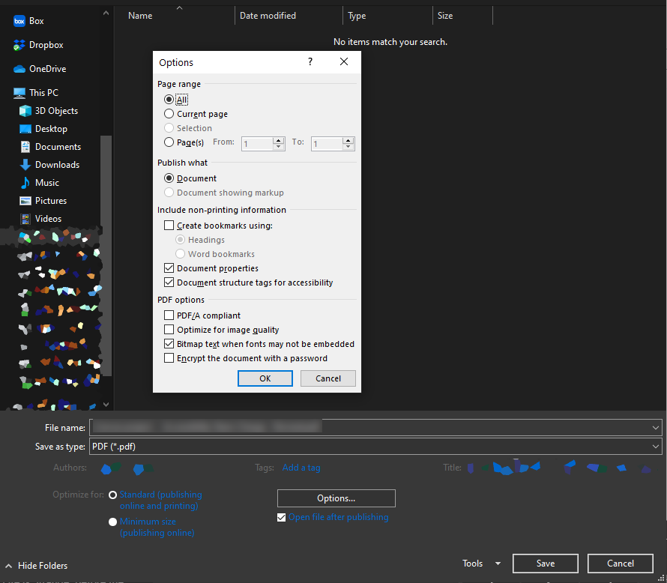
But I need, nay, crave PDFs!
There are times where you must use them, so make sure to produce them the best you can!
Open your File menu,
Choose Save As… then More Options…
  NEVER use Save as Adobe PDF
Options… again, then check
  Create bookmarks using: [headings]
  Document properties
  Document structure tags for accessibility
Finally, title and save your document.
This should result in a reasonably but imperfectly accessible PDF.
But please, use a DOCX whenever possible.

Slide 20
On Accommodation Statements
You may not always need them for your documents, but it is good practice to include them in places where documents may be accessed, or on the bottom of flyers, etc.
  If you require any accommodations to more fully participate in this event, please email (contact name) at (email).
  For questions about accessibility or to request accommodations please contact (name) at (email, phone).
  All participants are welcome. If you need disability-related accommodations, please call (number).
  May not just be related to disabilities!

Slide 21
Show me an example!
Note: If time has run low for a live example, or you could not see it, this presentation should give you all the same info.

Slide 22
In summary:
Word can do a lot!
Use headings, lists, and good formatting
Make sure any images used are described or marked decorative
Use the accessibility checker! Word and PowerPoint provide this in the Review tab of the Ribbon.
  But don’t rely on it! It’s only good at basic things.
Restrict your documents as you need.
Make sure you consider alternate formats and needs – try to avoid PDFs.
Provide accommodation statements where necessary!

Slide 23
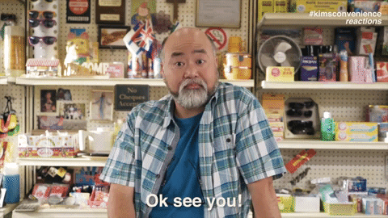
Call me beep me!
Mark McCarthy
Senior Accessibility Engineer
Administrative Information Technology Services
University of Illinois System Office
217-300-3408 | mcmccar2@uillinois.edu
Want more? I’ve got some friends for you!
Interacting with Customers with Disabilities with JJ Pionke
PDF Accessibility Basics with Christy Blew
Want to be certified in some accessibility basics (or advanced…s)?
  Look into UIUC’s IADP program (I’m an instructor!) or IAAP’s various offerings!
Kim’s Convenience, CBC TV

